Slide 1
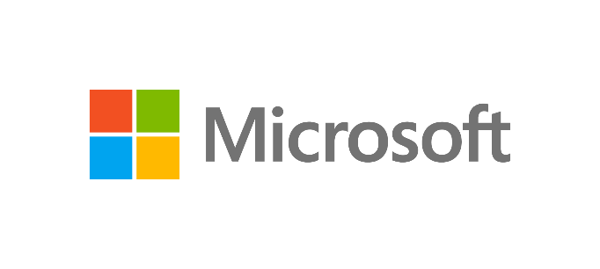
WS-011 Windows Server 2019 Administration
Notes:
Presentation: 90 minutes
Lab: 90 minutes
After completing this module, students should be able to:
Describe Remote Desktop Services (RDS).
Configure a session-based desktop deployment.
Describe personal and pooled virtual desktops.
Required materials:
To teach this module, you need the Microsoft PowerPoint file WS-011T00A_M09.pptx.
Preparation tasks
To prepare for this module:
Read all of the materials for this module.
Practice performing the demonstrations and the lab.
Work through the Module Review questions, and determine how you will use the information to reinforce student learning and promote knowledge transfer to on-the-job performance.
As you prepare for this class, it's imperative that you complete the lab yourself prior to the class. This gives you an understanding of how the lab works and the concepts that the lab covers. This enables you to provide meaningful hints to students who might have issues while working on the lab. Furthermore, it will help guide your lecture to ensure that you discuss the concepts that the lab covers.

Slide 2
Module 9: RDS in Windows Server

Slide 3
Module overview
In this module, you will be introduced to Remote Desktop Services, and learn about the functionality they provide. You will also learn how to configure an RDS Session-Based Desktop deployment and about Personal and pooled Virtual Desktops.
Lessons:
Overview of RDS
Configuring a session-based desktop deployment
Overview of personal and pooled virtual desktops
Notes:
Briefly introduce the module content to the students and ask them about their experience with RDS. Ask them if and how they're using RDS in their organization. Are they using session-based or virtual machine (VM)–based desktops?
RDS in Windows Server is an in-depth topic. Before teaching this module, you should try to set up a fully functional RDS environment following the guidelines at Welcome to Remote Desktop Services. If you haven´t worked with RDS, you should install it and study in-depth about the interface and settings prior to teaching the class.
© Microsoft Corporation

Slide 4
Lesson 1: Overview of RDS

Slide 5
Overview of RDS
In this lesson, you will be introduced to Remote Desktop Services (RDS) and how to plan a deployment. You will learn about the client experience and Remote Desktop features. You will also learn about RDS licensing, RD Gateway, and RDS in Azure.
Topics:
Remote Desktop Services overview and benefits
Client experience features with RDS
Remote Desktop Feature and RDS
Plan RDS deployment
Access RDS
Overview of Remote Desktop Gateway
RDS licensing
RDS in Azure
Notes:
Provide a brief overview of the lesson content.

Slide 6
Remote Desktop Services overview and benefits (1 of 2)
RDS is a virtualization technology that provides:
Session-based desktop deployments
VM-based desktop deployment
Remote programs (RemoteApp)
RDS benefits include:
Quick deployment of applications
Ease of application maintenance
Support for multiple device types
Good performance across slow connections
Data protection
Notes:
Explain how a site-to-site Virtual Private network (VPN) works and how to configure it correctly. You could use Microsoft Azure as an example. For more information, refer to VPN Gateway FAQ.
Also, consider demonstrating how to create a demand-dial interface on SEA-ADM1. You must install the Remote Access role before doing the demonstration. Stress that the name of the answering router’s demand-dial interface must match the name of the user account that you specify on the calling router. Finally, mention that it's important to avoid using the Point-to-Point Tunneling Protocol (PPTP) at all cost because it's not secure.

Slide 7
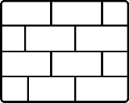
Remote Desktop Services overview and benefits (2 of 2)
RD Web
Access
RD Session
Host
RD Gateway
RD
Connection
Broker
RD Virtualization
Host
AD DS
RD Licensing
Notes:
Introduce the RDS role services and explain their role in an RDS deployment. For example, you can explain that a Remote Desktop Session Host (RD Session Host) is the server that provides a remote desktop and RemoteApp programs to clients. Mention that Remote Desktop Licensing (RD Licensing) is a critical role service. After the RD Licensing grace period, clients cannot connect to an RD Session Host if they don't have valid RDS client access licenses (RDS CALs).
Mention that each RDS deployment includes multiple role services, and you can manage them by using Server Manager or the Windows PowerShell command-line interface. If you prefer to use Windows PowerShell, be aware that the slide also covers Active Directory Domain Services (AD DS), as RDS can deploy only in an Active Directory environment, although AD DS is not an RDS role service.

Slide 8
Client experience features with RDS
Remote Desktop Protocol (RDP) provides an enhanced user experience with the following features:
Almost identical to a local experience
Full desktop or remote application window
Integrates with the Start screen
Redirection of local resources
Multi-monitor support
Windows media redirection
Single sign on
CPU, disk, and network Fair Share
Automatic reconnect
Notes:
Point out that when you connect to RDS, the user experience is similar to using local resources and running local applications. Mention that clients connect to RDS using RDP, which is platform independent and includes many optimizations. Also explain that Windows 10 and Windows Server 2019 support RDP 10.7, and that RDP is backwards compatible.
Use the slide to list and explain some of the Remote Desktop Protocol (RDP) features, which enable rich user experiences over local area networks (LANs) and wide area networks (WANs). You can mention that some of the features that are provided with Microsoft RemoteFX have been integrated into RDP since RDP 7.1.

Slide 9
Remote Desktop Feature and RDS (1 of 4)
What is RemoteFX?
Enhancement to RDP
Included in RDS:
RD Session Host–no additional requirements
RD Virtualization Host:
GPU, SLAT-enabled processor
Add RemoteFX 3D video adapter to virtual desktops
RemoteFX features:
RemoteFX for wide-area networks (WAN)
RemoteFX Adaptive Graphics
RemoteFX Media Streaming
RemoteFX Multi-Touch
RemoteFX USB Redirection
Notes:
Most students are probably already familiar with Remote Desktop, so focus on the differences between Remote Desktop and RDS. Use the first slide to introduce Remote Desktop and RDS. Use the second slide to compare them and explain the differences between them.

Slide 10
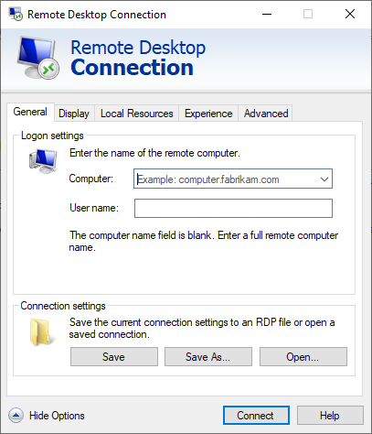
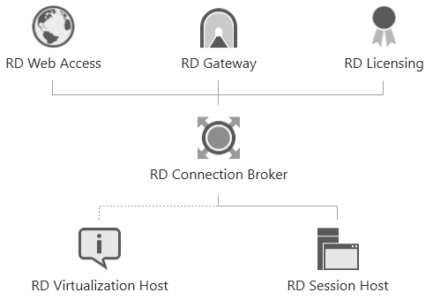
Remote Desktop Feature and RDS (2 of 4)
Remote Desktop
Remote Desktop Services
Use both features to observe remote computer desktops
Notes:
Point out that the primary intention of Remote Desktop is remote administration, while RDS provides an enhanced user experience and a standard remote environment that is accessible from almost any device. RDS also enables users to run remote applications and use remote resources because the application integrates with the local desktop.
Point out that Remote Desktop doesn't require additional licenses, but it allows two (or only one on the Windows client) connections, while RDS does not have such limitations. Remind students that the same client is used for connecting to Remote Desktop and RDS, and there is no limit to the number of connections that they can establish from the same Windows-based computer.

Slide 11
Remote Desktop Feature and RDS (3 of 4)
Feature | Remote Desktop | Remote Desktop Services
Availability | Windows Server and client Windows OS | Windows Server only
Additional licenses required | No | Yes
Number of concurrent connections | 2 (1 on client OS) | Unlimited
RemoteApp programs | No* | Yes
Drives, clipboard, and printers redirection | Yes | Yes
RemoteFX USB redirection, PnP redirection | No* | Yes
Multimedia redirection | No* | Yes
* Except with Windows Enterprise edition, when run in VM
Notes:
Explain the Remote Desktop Connection (RDC) client and remind students that it's included in the default Windows operating system (OS) installation. Mention that there are Windows Store apps that can be used for connecting to an RDS deployment in the Windows 10 OS interface, in addition to many other RDP clients for various platforms. Run a live demonstration of MSTSC to demonstrate all of its functionality.

Slide 12
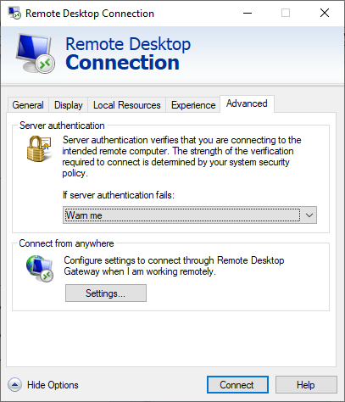
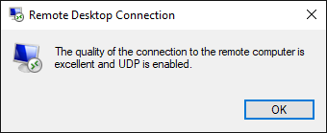
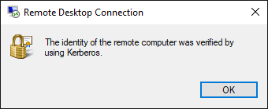
Remote Desktop Feature and RDS (4 of 4)
Desktop app is included in the Windows OS
Modern app is available at the Windows Store
Notes:
Mention that there are Windows Store apps that can be used for connecting to an RDS deployment in the Windows 10 OS interface, in addition to many other RDP clients for various platforms. Run a live demonstration of MSTSC to demonstrate all of its functionality.

Slide 13
Plan RDS deployment (1 of 8)
Assess Remote Desktop infrastructure requirements
Plan for RD session host
Plan for RD connection broker
Plan for RD web access
Plan for preserving user state
Infrastructure testing prior to rollout
Notes:
Briefly introduce each topic in this lesson. Point out that the planning step is important for each RDS deployment, especially when an RDS deployment must support many users.

Slide 14
Plan RDS deployment (2 of 8)
Assess Remote Desktop infrastructure requirements
Determine requirements and available resources including:
Whether RDS is an appropriate solution for your needs
Select a session-based or VM-based desktop deployment:
Both methods can be part of an RDS deployment
Determine how many users and the expected response time
Estimate server hardware and network requirements
Determine RDS client types and their requirements
Determine how clients will access RDS
Notes:
Remind students that before they deploy RDS, they first should assess the existing environment and document the challenges that RDS should solve. They should also consider the expected number of users and how they will access RDS.
This topic is designed to get students thinking about the questions that should be answered before starting an RDS implementation. Not every consideration is applicable in all situations. Start a discussion and ask what else should be considered before an RDS deployment. This topic is intended to be an interactive discussion with students.

Slide 15
Plan RDS deployment (3 of 8)
Plan for RD Session Host
RD Session Host provide desktops and RemoteApp programs
When you plan for an RD Session Host consider the:
Number of concurrent user sessions
Types of applications that users will run
Major hardware factors, including CPU, memory, disk, and network
Deploy a pilot project and run load simulations to simulate user activity
Deploy multiple RD Session Hosts for high availability
Notes:
Introduce RD Session Host and its role in RDS deployment. Explain that it's a mandatory role service for each session-based desktop deployment of RDS. Point out that the number of concurrent users and the type of applications that they use are the main planning considerations.
Ask students what they think would be the most critical resources and potential bottlenecks on an RD Session Host. Discuss how you can estimate hardware requirements for a certain number of users. Be sure to explain that an RDS deployment can have multiple RD Session Hosts.
Don't spend too much time discussing high availability, which is covered in the next lesson on high availability options for RDS.

Slide 16
Plan RDS deployment (4 of 8)
Plan for RD Connection Broker
The entrance point to an RDS deployment:
Distributes a session among RD Session Hosts
Reconnects users to existing sessions
Publishes the RD Web feed of available RDS resources
Configures the RDS servers in the same collection
RD Connection Brokers use an internal database for tracking connections
Use SQL Server and multiple brokers for high availability
RD Web
Access
RD Virtualization
Host
RD
Connection
Broker
RD Session Host
Notes:
Introduce the role of RD Connection Broker in an RDS deployment. Mention that even though RD Connection Broker is not a mandatory role service in each RDS deployment, you'll never properly deploy RDS without it.
Describe how RD Connection Broker can track sessions that are connected to RD Session Hosts, and how it's used when a user reconnects to their existing session. Mention that RD Connection Broker provides high availability for other RDS role services (except personal virtual desktops) by load-balancing client requests.
Mention that although it's a very important role service, RD Connection Broker can present a single point of failure. However, you can remedy this by configuring high availability for it. To do this, you install it on multiple servers and store its data on a computer that's running Microsoft SQL Server data management software, or you could use Azure SQL Databases. Don't spend too much time discussing high availability, which is covered in the next lesson on high availability options for RDS.

Slide 17
Plan RDS deployment (5 of 8)
Plan for RD Web Access
RD Web Access is part of any RDS deployment
Provides a web portal with available RDS resources:
Personalized, shows only available RDS resources
RD Web feed can integrate with the Start screen
Clients can launch connections from a portal
RD Web Access requires secure (HTTPS) connections:
SSL certificate can be self-issued (for testing only)
Internal CA or non-Microsoft SSL certificate should be used
Use multiple servers and NLB for high availability
Notes:
Remind students that Remote Desktop Web Access (RD Web Access) is a mandatory role service in any RDS deployment. Explain that it provides a web portal with available RDS resources, which includes remote desktops, RemoteApp programs, and virtual desktops. Users can access an RD Web Access portal from any web browser. It also provides an RDWeb feed, which includes available RDS resources and can integrate with a client’s Start screen.
Discuss the main RD Web Access planning considerations, which include Secure Sockets Layer (SSL) certificate planning, providing clients with an RDWeb feed, and providing high availability for RD Web Access. Focus on the first two because a separate lesson covers high availability.

Slide 18
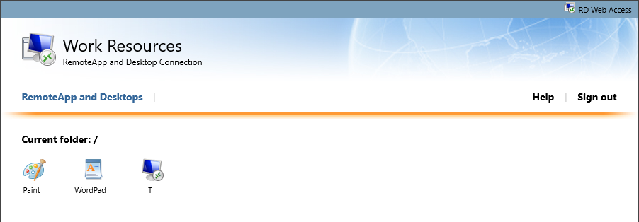
Plan RDS deployment (6 of 8)
RD Web portal
Notes:
Use this slide to introduce the RD Web Access portal. Point out the security warning because of the self-issued SSL certificate. Also point out that they should use the portal for initiating connections to RDS resources—not the RDC client itself.

Slide 19
Plan RDS deployment (7 of 8)
Plan for preserving user state:
Use user state virtualization for preserving user state
Roaming user profiles and Folder Redirection makes the same user state on any domain computer possible
When you plan user profile disks, you must:
Store a user profile in a separate .vhdx file
Create a separate .vhdx file for each user
Configure which profile folders are included or excluded
Store user profile disks on a network share
User profile disks are only available to collections
User profile disks cannot be shared between collections
Ensure that enough storage is available for user state
Notes:
Explain options for preserving user state when you connect to an RD Session Host. Students should be familiar with Windows user state virtualization, so don't spend much time on roaming user profiles and Folder Redirection. Emphasize only that if configured, both are available on any domain computer on which a user signs in.
Introduce user profile disks as an RDS-specific feature that stores each user profile in a separate virtual hard disk file. Explain user profile disk features and emphasize that they are available only on RDS—you cannot use user profile disks if users don't sign in to an RD Session Host or a Remote Desktop Virtualization Host (RD Virtualization Host).

Slide 20
Plan RDS deployment (8 of 8)
Infrastructure testing prior to rollout:
Testing is critical for successful RDS deployment
During testing consider the following questions:
Did the testing environment meet expectations?
Can users transparently access the RDS deployment?
Did the application consume system resources as expected?
Are all user environment scenarios being tested?
Is infrastructure hardware running as expected?
Is RDS responsive, and can it support the expected users?
Were there any unexpected changes during testing?
Errors are much easier to resolve during testing than during deployment
Notes:
Emphasize the importance of testing, preferably on a small scale, for a successful RDS deployment. Mention some of the considerations and questions that you should answer during testing. Ensure that students understand the importance of eliminating errors in a deployment through testing, and that problems are much easier to resolve during testing than during full deployment. This can be a good discussion topic.

Slide 21
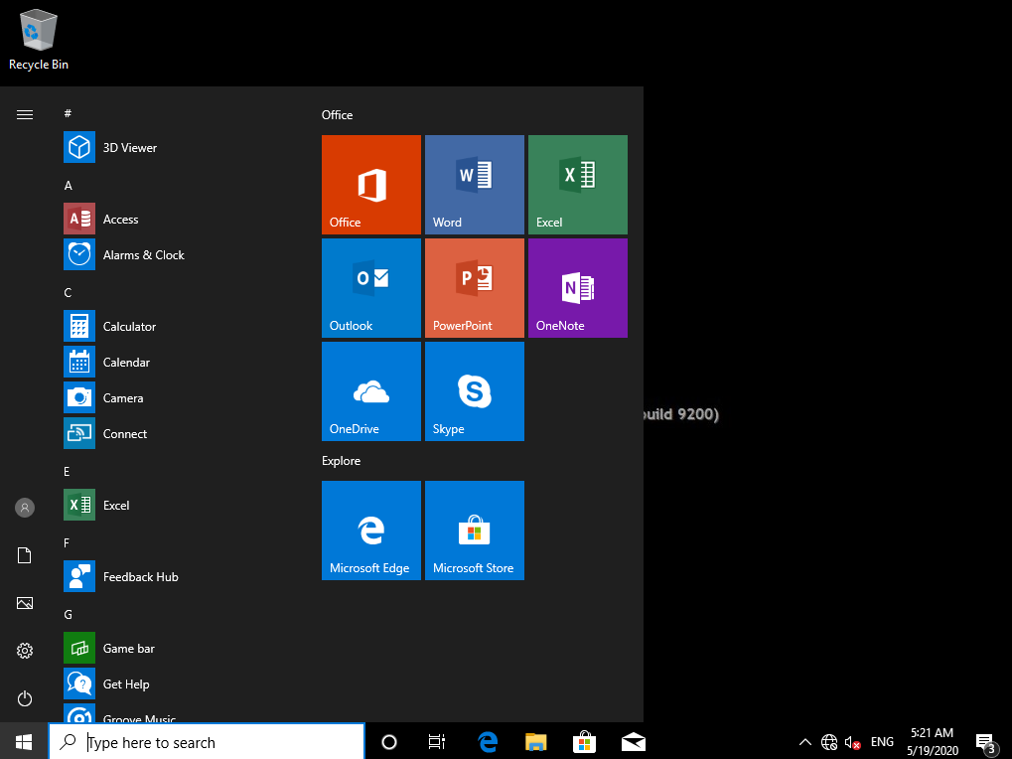
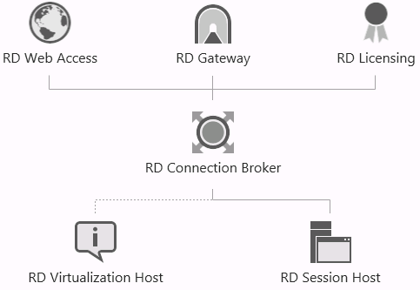
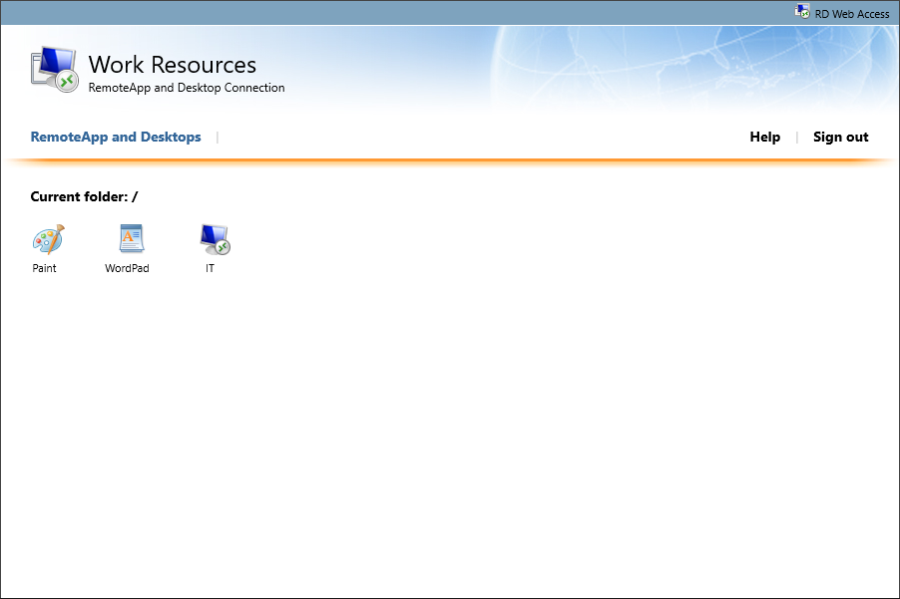
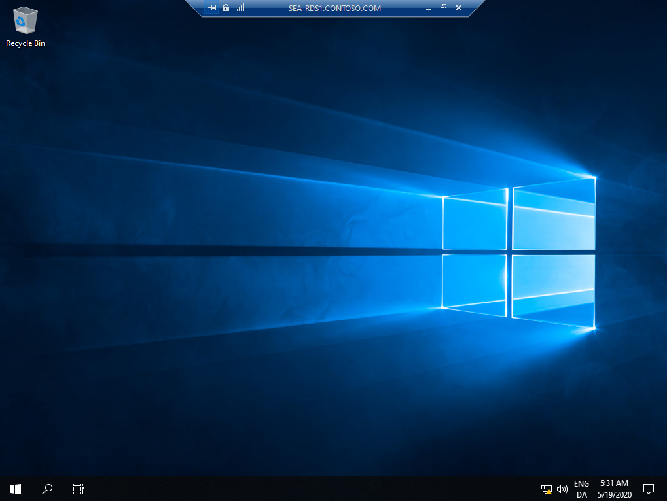
Access RDS (1 of 3)
RD Web Access portal lists available RDS resources:
Connection is initiated in RDC
RD Web feed for RemoteApp and Desktop Connections
RDC client connects to a full remote desktop only if it is started manually
RemoteApp and Desktop Connections
RDS deployment
RD Web Access
RDC client
Notes:
Describe three ways of accessing RDS and RemoteApp programs. Briefly explain what RemoteApp is, but don't go into details as RemoteApp is covered in the next lesson. Point out that although it's possible to connect directly to an RD Session Host server by using RDC, this isn't a recommended practice. If you start RDC manually, you can connect only to a full remote desktop, not to individual applications. However, when a connection is established, you can also start applications that are published as RemoteApp programs. Remind students that you should connect to RemoteApp programs either from an RD Web Access portal or from RemoteApp and Desktop Connections.
Describe both methods and point out the benefits and requirements of each method. Don't forget to mention that RD Web Access is configured with a self-issued SSL certificate that clients don't trust, and it must be replaced if you want to use RemoteApp and Desktop Connections to add connections to an RD Web feed.

Slide 22
Access RDS (2 of 2)
What Is RemoteApp and Desktop Connections?
Adds available RDS resources on the Start screen
Can be configured manually or by Group Policy
Connection specified by URL or email address
Uses RD Web Access feed from RD Web Access:
RD Web Access server must have a trusted certificate
Benefits:
Only RDS resources that the user can access are added
List of available RDS resources updates automatically
File type associations apply to RemoteApp programs
Search works with RDS resources
Can be added regardless of domain membership
Notes:
Describe what the RemoteApp and Desktop Connections feature is. Explain that it adds available RDS resources to the Start menu on a client, and that you can configure it manually or by using Group Policy.
Describe how you can add a connection by specifying a connection URL or by using a user’s email address providing it's configured manually. However, you can only use a URL if it's configured by Group Policy. Explain what must be added in Domain Name System (DNS) to be able to use an email address.
Remind students that published RDS resources are added in the Start menu Apps section, in the Work Resources (RADC) section.

Slide 23
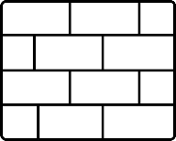

Overview of Remote Desktop Gateway (1 of 3)
Remote users can connect to an RDS deployment from a public network through RD Gateway
Public network
Internal network
Strips off HTTPS
Passes RDP traffic to RDS
RD Session Host
Home
HTTPS / 443
Hotel
RD Gateway
RD Virtualization
Host
NPS
Partner or client
Other RDP hosts
AD DS
Notes:
Use this slide as a discussion topic by asking students if they can access their work environment from the classroom, and if so, if they first need to establish a VPN.
Point out changes in today’s work environment and the need for users to access their work environments from anywhere. Mention broad availability and frequent use of mobile devices such as smartphones or tablets. Then ask if students’ organizations allow RDP connections from a public network, such as the internet and if so, why.

Slide 24
Overview of Remote Desktop Gateway (2 of 3)
Why Is Remote Access Important for RDS?
RDS provides a consistent user environment
Users need access to RDS from anywhere, regardless of whether they are connected to the organization’s network
Challenges with remote access to RDS:
Access must be secure and encrypted
Standard protocol should be used
Minimal firewall reconfiguration
Control who can connect remotely
Control which RDS resources can be accessed
Monitor and manage established connections
Provide high availability
Require additional authentication (optional)
Notes:
Explain the importance of the central entry point, which provides secure and controlled access from a public network to an internal network. Mention that such entry points should be highly available; you should be able to control who can access the internal network and which internal resources they can use. Explain that this is exactly the solution that RD Gateway provides.

Slide 25
Overview of Remote Desktop Gateway (3 of 3)
Control access to RDS via Remote Desktop Gateway
RD authorization policies control access in two ways:
Remote Desktop connection authorization policies (RD CAPs) control who can establish a connection to an RD Gateway server
Remote Desktop resource authorization policies (RD RAPs) control to which computers connections can be established through an RD Gateway server
Authorization policies provide additional limitations such as:
Redirection, session timeouts, and allowed ports
User must match RD CAP and RD RAP to access resources through an RD Gateway server
The default policies allow Domain User groups full network access
Authorization policies are stored locally by default
Notes:
Remind students that when you install RD Gateway, by default, all domain users can connect to any internal computer on RDP port 3389 through the RD Gateway. Point out that RD Gateway authorization policies control who can connect to RD Gateway and which internal resources can be accessed through the RD Gateway. Briefly explain Remote Desktop connection authorization policy (RD CAP), Remote Desktop resource access policy (RD RAP) but don't go into detail. Mention that by default, RD CAPs and RD RAPs store locally, and users must match an RD CAP and an RD RAP to connect to internal resources through RD Gateway.

Slide 26
RDS licensing
RD Session Host
RDS CAL is required on each connection, including:
RDS Per User CAL
RDS Per Device CAL
RDS External Connector License
RD Virtualization Host
You must license OSs on VMs:
Windows VDA required if a client is not covered by Software Assurance (SA)
Applications are licensed separately from RDS
Notes:
Use this slide to explain the basics of RDS licensing. Remind students that each client that connects to an RD Session Host must have a valid RDS CAL, a licensed and locally installed OS, and Windows CAL if the device is a domain member.
Point out the two types of RDS CALs—the RDS Per User CAL and the RDS Per Device CAL—and explain when to use each them. Then explain the RDS External Connector License, and that it can be beneficial when many external users need to access an RD Session Host. Make sure students understand that an RDS Per User CAL and an RDS Per Device CAL allow you to connect to multiple RDS servers, while the RDS External Connector License must be obtained for each RD Session Host server in a deployment.
Cover the basics of a VM-based desktop deployment of RDS. Point out that OSs that are installed on VMs on an RD Virtualization Host, typically Windows 10 must be licensed. Other devices that access virtual desktops must be licensed. A Microsoft Software Assurance (SA) agreement can cover those devices, or Windows Virtual Desktop Access (Windows VDA) must be purchased if an SA does not cover a device.

Slide 27
RDS in Azure
You have the following options for running RDS in Azure:
RDS running on virtual machines in Azure
Use Azure Marketplace offering to install a complete RDS environment
Use Azure QuickStart template to create customized RDS environment
Use Windows Virtual Desktops
Is a Platform as a service (PaaS) offering in Azure with all management roles
Supports pooled and personal desktops
Requires licenses
Microsoft 365 E3, E5, A3, A5, F3
Windows 10 Enterprise E3, E5, A3, A5
Uses Windows 10 Enterprise multi-session
Azure resources cost
Notes:
Windows Virtual Desktops (WVD) will probably be new for many instructors and a lot of students. Use the resources at Windows Virtual Desktop documentation to familiarize yourself with WVDs. If you access to an Azure subscription you could demo how to find the RDS offering in the Azure Marketplace, and start the wizard to demonstrate how easy it is to use. You could also review a few of the RDS Quickstart templates as well.
Introduce the students to the various ways that you can run RDS in Azure. Emphasize that the Azure Marketplace offering is also a great way to get RDS up and running quickly and that this approach is best suited for test environment. If you want to customize your RDS environment, you should use Azure Quickstart templates.
Explain that WVDs in an Azure platform-as-a-service (PaaS) offering doesn't require you to install any RDS management infrastructure such as RDS roles, including RD Web, Remote Desktop Connection Broker (RD Connection Broker), RD Gateway, and Remote Desktop License (RD License) server.
Go through the technical and license requirements for WVD. Explain that Windows 10 Enterprise multi-session allows more than one concurrent RDP connection compared to a normal Windows 10 Enterprise. One way of using Windows 10 Enterprise multi-session is that many users can share the same VM in Azure and connect at the same time. That is great way of saving money because you don't need a VM for each user that connect to a WVD.
Emphasize that Windows 10 Enterprise multi-session is only supported when used with WVD, and that you cannot use the normal Remote Connection Client (MSTSC) to connect to WVDs. You must download the Windows Desktop Client, which is available for the following platforms: Windows Desktop, Web, macOS, iOS and Android.

Slide 28
Lesson 2: Configuring a session-based desktop deployment

Slide 29
Configuring a session-based desktop deployment
In this lesson you will be introduced to session-based desktop deployments, including collections and collection settings. You will learn how to install RDS, create, and configure collections. You will also learn about high availability options for RDS and get an overview of RemoteApp.
Topics:
Overview of the session-based desktop deployment process
Demonstration: Install RDS
What is a collection?
Configure session collection settings
Demonstration: Create and configure a session collection
High availability options for RDS
Overview of remote app
Notes:
Provide a brief overview of the lesson content.

Slide 30
Overview of the session-based desktop deployment process
Before the deployment, add servers to Server Manager
Avoid installing individual RDS role services because you can only manage RDS deployment
Session-based desktop deployment steps:
Select Remote Desktop Services Installation option
Choose Standard or Quick Start deployment
Choose virtual machine-based or session-based deployment
Choose where to install RDS role services
After RDS installs you can:
Add more servers to the RDS deployment
Perform configuration of the RDS deployment
Notes:
Explain that in Windows Server 2012 R2 or later, you can't manage individual RDS role services—only an RDS deployment. Point out which RDS role services are required in an RDS deployment, and briefly introduce the session-based desktop deployment steps. Be aware that the next topic is a demonstration where you will demonstrate all of these steps.
Don't forget to emphasize that in Server Manager you first need to add all servers on which you plan to install RDS role services. Point out that Server Manager can manage only the servers of which it is aware.
Mention that the RD Session Host restarts during installation and that you would probably add additional servers to the RDS deployment after the installation finishes.

Slide 31
Demonstration: Install RDS
Install RDS using Server Manager
Install RDS using PowerShell
Notes:
Demonstration steps
Install RDS using Server Manager
On SEA-RDS1, select Start, and then select the Server Manager tile.
In Server Manager, select Manage, and then select Add Roles and Features.
In the Add Roles and Features Wizard, on the Before you begin page, select Next.
On the Select installation type page, select Remote Desktop Services installation, and then select Next.
On the Select deployment type page, verify that Standard deployment is selected, and then select Next.
Note: Even though, we could have selected the Quick Start deployment option and have all three required RDS role services installed on SEA-RDS1, you selected the Standard deployment option to demonstrate how to select different servers for the RDS role services. Furthermore, the Quick Start deployment option will create a collection named QuickSessionCollection and publish the RemoteApp programs Calculator, Paint, and WordPad.
On the Select deployment scenario page, select Session-based desktop deployment, and then select Next.
On the Review role services page, review the description of the role services, and then select Next.
On the Specify RD Connection Broker server page, in the Server Pool section, select SEA-RDS1.Contoso.com . Add the computer to the Selected section by selecting the Right arrow key, and then select Next.
On the Specify RD Web Access server page, in the Server Pool section, select SEA-RDS1.Contoso.com . Add the computer to the Selected section by selecting the Right arrow, and then select Next.
On the Specify RD Session Host servers page, in the Server Pool section, select SEA-RDS1.Contoso.com . Add the computers to the Selected section by selecting the Right arrow, and then select Next.
On the Confirm selections page, select Cancel.
Install RDS using Windows Server PowerShell
Note: We will now demonstrate how to install RDS using Windows PowerShell. The previous steps were included to demonstrate how to install RDS using Server Manager.
Switch to SEA-DC1, and at the Windows PowerShell command prompt enter the following command, and then select Enter: powershell
Enter the following command, and then select Enter: $SVR="SEA-RDS1.contoso.com"
Enter the following command, and then select Enter: New-RDSessionDeployment -ConnectionBroker $SVR -WebAccessServer $SVR -SessionHost $SVR
Wait for the installation to complete and for SEA-RDS1 to restart automatically. This will take approximately 5 minutes.

Slide 32
Demonstration: Install RDS (2 of 2)
Install RDS using Server Manager
Install RDS using PowerShell
Notes:
Switch to SEA-RDS1, and sign in as Contoso\Administrator with the password Pa55w.rd
Select Start, and then select the Server Manager tile.
Wait for Server Manager to refresh.
In Server Manager, in the navigation pane, select Remote Desktop Services, and then minimize Server Manager.
After completing the demonstration, leave all the virtual machines running as you will be using them in their current state in a later demonstration.

Slide 33
What is a collection?
A collection is a logical grouping of servers or virtual machines including:
Session collections
Virtual desktop collections
Manage collections as a unit to:
Simplify and centralize administration
Apply the same settings to all servers in a collection
Manage collections not individual collection members
Servers can only be in one collection:
Multiple collections are required if servers must be configured differently
A collection can provide high availability because client requests can be directed to any collection member
Notes:
Introduce the concept of collections to students. You can mention that RDS supports two collection types: session collections and virtual desktop collections. Focus on session collections. Explain that collections simplify administration because you can manage a collection as a unit instead of individual servers in the collection. Mention that RD Connection Broker applies collection settings to the servers in a collection. Also mention that servers in a collection should have similar configurations, including installed applications.
Explain reasons for having multiple connections: you need to configure the same settings differently for different servers.
Point out that when you create a collection, it must have at least one server. Remind students that collections can provide high availability for the resources in a collection, for example remote desktops or RemoteApp programs. If a collection has multiple servers, a client request will automatically direct to an available server in a collection.

Slide 34
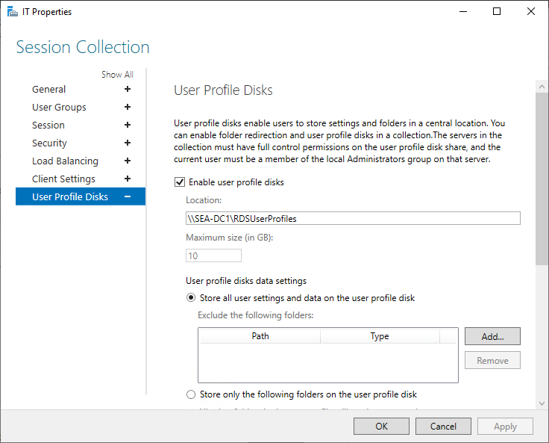
Configure session collection settings
Notes:
Use this slide to introduce students to settings that you can configure for a session collection. Point out that only a few of the settings can be configured when you create a collection, but all of them can be configured after you create the collection. Remind students that they can configure session collection properties in Server Manager, or by using Windows PowerShell. Don't spend too much time on this topic though, as you will demonstrate how to configure session collection settings in the next demonstration.

Slide 35
Demonstration: Create and configure a session collection
Create and configure a session collection using Server Manager
Create and configure a session collection using PowerShell
Connect to RD Session Host from client
Notes:
Demonstration steps
Create and configure a session collection using Server Manager
Use the following steps to create a session collection using Server Manager:
On SEA-RDS1, open Server Manager, and then select Remote Desktop Services.
On the Remote Service Overview page, select Collections.
In the details pane under COLLECTIONS, select TASKS, and then select Create Session Collection.
In the Create Collection Wizard, on the Before you begin page, select Next.
On the Name the collection page, in the Name field, enter Demo, and then select Next.
On the Specify RD Session Host servers page, in the Server Pool section, select SEA-RDS1.Contoso.com .
Add the computer to the Selected section by selecting the Right arrow, and then selecting Next.
On the Specify user groups page, select Next.
On the Specify user profile disks page, clear the check box next to Enable user profile disks, and then select Next.
On the Confirm selections page, select Cancel, and then when prompted, select Yes.
Minimize Server Manager.
Create and configure a session collection using Windows PowerShell
Use the following steps to create a session collection using Windows PowerShell:
ON SEA-RDS1, right-click or access the context menu for Start, and then select Windows PowerShell (Admin).
In Windows PowerShell, at the command prompt, enter the following command, and then select Enter:
New-RDSessionCollection –CollectionName Demo –SessionHost SEA-RDS1.Contoso.com –CollectionDescription “This Collection is for Demo purposes” –ConnectionBroker SEA-RDS1.Contoso.com
Wait for the command to complete, which will take approximately 1 minute.
Maximize Server Manager, and then select Overview.
Refresh Server Manager by selecting F5.
In Server Manager, in the navigation pane, select Collections, and verify that a collection named Demo is listed in the details pane.
In the navigation pane, select the Demo collection.
Next to **PROPERTIES, select TASKS, and then select Edit Properties.
On the Session Collection page, select the various settings and notice how the collection is configured.
Select Client Settings, and verify that both Audio and video playback and Audio recording are enabled.
In the Demo Properties dialog box, select Cancel.
Minimize Server Manager.

Slide 36
Demonstration: Create and configure a session collection (2 of 3)
Create and configure a session collection using Server Manager
Create and configure a session collection using PowerShell
Connect to RD Session Host from client
Notes:
In Windows PowerShell, enter the following command, and then select Enter:
Get-RDSessionCollectionConfiguration –CollectionName Demo –Client | Format-List
Examine the output, and notice that next to ClientDeviceRedirectionOptions the following are listed:
AudioVideoPlayBack
AudioRecording
PlugAndPlayDevice
SmartCard
Clipboard
LPTPort
Drive
Enter the following command, and then select Enter:
Set-RDSessionCollectionConfiguration –CollectionName Demo –ClientDeviceRedirectionOptions PlugAndPlayDevice, SmartCard,Clipboard,LPTPort,Drive
Enter the following command, and then select Enter:
Get-RDSessionCollectionConfiguration –CollectionName Demo –Client | Format-List
Examine the output and notice that next to ClientDeviceRedirectionOptions, only the following entries are now listed:
PlugAndPlayDevice
SmartCard
Clipboard
LPTPort
Drive
Connect to Remote Desktop Session Host (RD Session Host) from a client
On SEA-CL1, on the taskbar, select the Microsoft Edge icon.
In Microsoft Edge, in the address bar, enter https://SEA-RDS1.Contoso.com/rdweb , and then select Enter.
On the This site is not secure page, select Details, and then select Go on to the webpage.
Note: You are getting this warning because Remote Desktop Web (RD Web) is using a self-signed certificate that is not trusted by the client. In a real production deployment, you would use trusted certificates.
On the RD Web Access page, in the Domain\user name field, enter contoso\jane. In the Password field, enter Pa55w.rd, and then select Sign in.
If prompted by Microsoft Edge to save the password, select Never.

Slide 37
Demonstration: Create and configure a session collection (3 of 3)
Create and configure a session collection using Server Manager
Create and configure a session collection using PowerShell
Connect to RD Session Host from client
Notes:
On the RD Web Access page, under Current folder: /, select Demo, and then when prompted, select Open.
In the Remote Desktop Connection dialog box, select Connect.
Note: You are receiving the Unknown publisher warning because you have not yet configured certificates for RDS.
In the Windows Security dialog box, in the Password field, enter Pa55w.rd. You are now connected to the RD Session host.
In the RDP connection, right-click or access the context menu for Start, select Shut down or sign out, and then select Sign out.
On the RD Web Access page, select Sign out.
Close Microsoft Edge.
After completing the demonstration, revert all VMs.

Slide 38
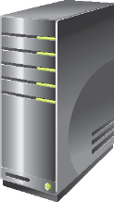


High availability options for RDS
Multiple servers in
an RDS deployment
Hyper-V
failover cluster
RD
Connection
Broker
Broker
RD Virtualization
Host
RD Web Access
RD
Connection
Broker
RD Web Access
Host
WID
SQL Server
failover cluster
failover cluster
Additional servers in
an RDS deployment
RD Session Host
RD Gateway
RD Session Host
RD Gateway
Multiple servers in
a collection
RD Licensing
RD Licensing
Notes:
Briefly mention how to achieve high availability for the RD Connection Broker and RD Session Host servers. Focus on how to provide high availability for RD Web Access, RD Licensing, RD Virtualization Host, and RD Gateway. Mention that you can achieve high availability if you add additional servers to an RDS deployment, and that for high availability of personal virtual desktops, you should have RD Virtualization Host servers in failover clustering.
Explain that you can achieve high availability for RD Session Host when you add multiple RD Session Host servers to the same collection. Discuss how a collection provides high availability and how RD Connection Broker redirects client requests only to available servers in a collection

Slide 39
Overview of RemoteApp Programs
RemoteApp programs run remotely and integrate with a local desktop
RemoteApp programs are especially useful in several scenarios:
Remote users
Line-of-business application deployments
Roaming users
RemoteApp program features:
Start programs with no additional prompts
Run in its own resizable window
Use file type associations to start a program
Window content is shown during move and resize
Live thumbnails and application switching
Similar icons as locally installed applications
Notifications and icon overlay
Notes:
Provide an overview of RemoteApp programs. Point out that RemoteApp programs run on RD Session Host servers while their windows display on clients. List the RemoteApp features and in which scenarios they can be especially beneficial. If students are familiar with RemoteApp programs, don't spend too much time on this topic.

Slide 40
Lesson 3: Overview of personal and pooled virtual desktops

Slide 41
Overview of personal and pooled virtual desktops
Always On VPN is the next generation VPN solution for Windows 10 devices. It provides very secure access to the internal data and applications and the VPN connection is fully automated.
Topics:
Overview of VM-based desktop deployments of Virtual Desktop Infrastructure (VDI)
Overview of pooled virtual desktops
Overview of personal virtual desktops
Compare VDI options
High availability for personal and pooled desktops
Prepare a virtual desktop template
Notes:
Provide a brief overview of the lesson content.

Slide 42
Overview of VDI VM-based desktop deployments
A virtual machine (VM)-based desktop deployment of VDI provides:
An automated infrastructure for creating VMs
Dedicated resources to each VM user
RD Web Access
RD Connection Broker
RD Virtualization Host
Notes:
Use the graphic on the slide to explain the user connection process. Take a few moments to ensure that students understand the difference between a Microsoft VM-based desktop deployment of Virtual Desktop Infrastructure (VDI) and an RDS session-based desktop deployment of VDI.

Slide 43
Overview of pooled virtual desktops
Pooled virtual desktops:
Are identically configured VMs
Are not assigned to a specific user
Do not retain user state information
Are created from a virtual desktop image
Notes:
Use this topic to introduce how to use and configure pooled virtual desktops. The primary goal of this topic is to provide enough information to differentiate pooled virtual desktops from personal virtual desktops.

Slide 44
Overview of personal virtual desktops
Personal virtual desktops are:
Assigned to specific users
Can be customized
Create personal virtual desktops:
Based on a virtual desktop image
From an existing VM
Notes:
Use this topic to help students understand how personal virtual desktops are different from pooled virtual desktops.

Slide 45
Compare VDI options
 | Session-based desktop deployment of VDI | Pooled virtual desktops | Personal virtual desktops
Personalization | Good | Good | Best
Application compatibility | Good | Best | Best
Ease of management | Best | Good | Fair
Cost effectiveness | Best | Good | Fair
Notes:
Use this slide to review the differences and similarities between session-based desktop deployments of VDI and VM-based desktop deployments of VDI. The best choice depends on the individual scenario.

Slide 46
High availability for personal and pooled desktops (1 of 2)
Server role | High availability method
RD Connection Broker | Domain name system (DNS) round robin and Microsoft SQL Server configured to store RD Connection Broker configuration
RD Web Access | Load balancing
RD Virtualization Host | Multiple RD Virtualization Hosts
Notes:
Ensure that students understand how high availability works for pooled virtual desktops. It's important that they understand there is no high availability for individual pooled virtual desktops.

Slide 47

High availability for personal and pooled desktops (2 of 2)
Failover clustering makes personal virtual desktops highly available:
There is no downtime with Live Migration
There is brief downtime after RD Virtualization Host failure
Failover clustering requires:
Shared storage
Multiple networks
Notes:
Use this topic to introduce how failover clustering can make VMs highly available. Remember, this is just an introduction and there's no need to go into great detail here.

Slide 48
Prepare a virtual desktop template
A virtual desktop template:
Is a VM that functions as a starting point for personal or pooled virtual desktops
Must be configured appropriately
Automate the process using a script or Microsoft Endpoint Configuration Manager
Create a VM
Optimize applications
Install the OS
Optimize the OS
Install applications
Run Sysprep
Notes:
Describe what a virtual desktop template is and the process for creating one. Stress that you must configure a virtual desktop template properly, and that even though you could create this template manually the first few times, it should be automated. You can use Microsoft Endpoint Configuration Manager to automate Virtual Desktop template creation.
Also explain about the considerations for activation, applications, antivirus, and optimization when creating the Virtual Desktop template. Point the students to Windows_10_VDI_Optimize.

Slide 49
Instructor-led labs: Implementing RDS in Windows Server
Implementing RDS
Configuring Session Collection Settings and using RDS
Configuring a virtual desktop template

Slide 50
Lab: Implementing RDS in Windows Server
Exercise 1: Implementing RDS
Exercise 2: Configuring Session Collection Settings and using RDS
Exercise 3: Configuring a virtual desktop template
Sign in information for the exercise(s):
Virtual machines:
WS-011T00A-SEA-DC1
WS-011T00A-SEA-RDS1
WS-011T00A-SEA-CL1
Username: Contoso\Administrator
Password: Pa55w.rd
Sign in to WS-011T00A-SEA-CL1 as Contoso\Jane using same password as above.

Slide 51
Lab scenario
You have been asked to configure a basic RDS environment as the starting point for the new infrastructure that will host the sales application. You would like to deploy RDS services, perform initial configuration, and demonstrate to the delivery team how to connect to an RDS deployment.
You are evaluating whether or not to use user profile disks for storing user profiles and making the user profile disks available on all servers in the collection. A coworker reminded you that users often store unnecessary files in their profiles, and you need to explore how to exclude such data from the profile and set a limit on the profile size.
As the sales application will publish on the RD Web Access site, you have to learn how to configure and access RemoteApp Programs from the RD Web Access portal.

Slide 52
Module-review questions (1 of 2)
Which RDS role service tracks user sessions across multiple RD Session Host servers and virtual desktops?
RD Session Host
Remote Desktop Virtualization Host
RD connection Broker
Remote Desktop Web Access
Remote Desktop Gateway
2. Can you connect to RDS only from a Windows-based computer?
3. In which tool can you publish RemoteApp programs on an RD Session Host server?
4. You are creating a new virtual desktop template for a group of users. You have created and configured the VM. You have optimized the VM appropriately for use as a virtual desktop. What is the final step in preparing a virtual desktop template?

Slide 53
Module-review questions (2 of 2)
5. Which port must you allow on your firewall to enable external clients to use RD Gateway to connect to internal RDS resources?

Slide 54
Module-review answers (1 of 2)
Which RDS role service tracks user sessions across multiple RD Session Host servers and virtual desktops?
RD connection Broker
Can you connect to RDS only from a Windows-based computer?
No. You can connect to RDS from any device that has a Remote Desktop Protocol (RDP) client, regardless of whether it is running Windows or any other operating system (OS), or if the device is a domain member or not.
In which tool can you publish RemoteApp programs on an RD Session Host server?
You cannot publish RemoteApp programs on an individual RD Session Host server. You can only publish them per session collection, which means that they will publish for all RD Session Host servers in that collection. You can publish RemoteApp programs by using Server Manager or Windows PowerShell.

Slide 55
Module-review answers (2 of 2)
You are creating a new virtual desktop template for a group of users. You have created and configured the VM. You have optimized the VM appropriately for use as a virtual desktop. What is the final step in preparing a virtual desktop template?
The final step in preparing a virtual desktop template is to run Sysprep and shut down the VM.
Which port must you allow on your firewall to enable external clients to use RD Gateway to connect to internal RDS resources?
Clients connect to RD Gateway by using the HTTPS protocol, which uses TCP port 443 by default.

Slide 56
Thank you.
Notes:
Always end the presentation with the Thank You slide. Do not remove.

